Slide 1


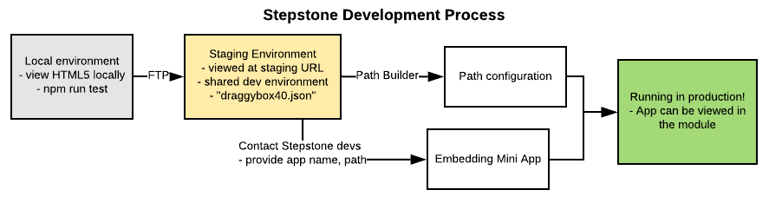
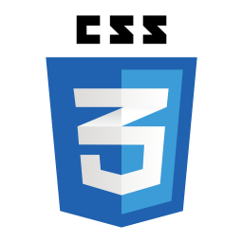






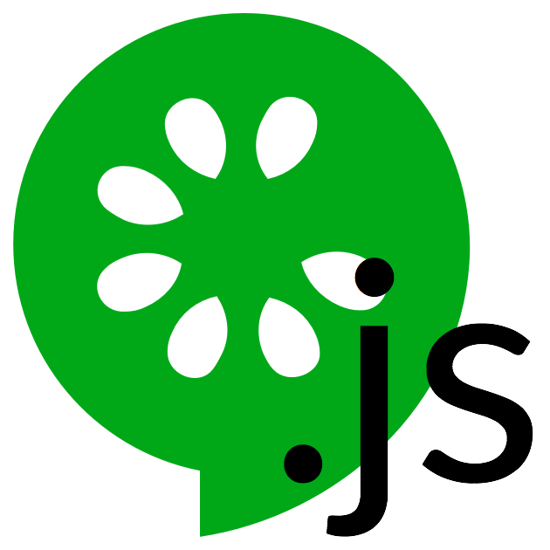
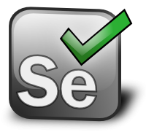


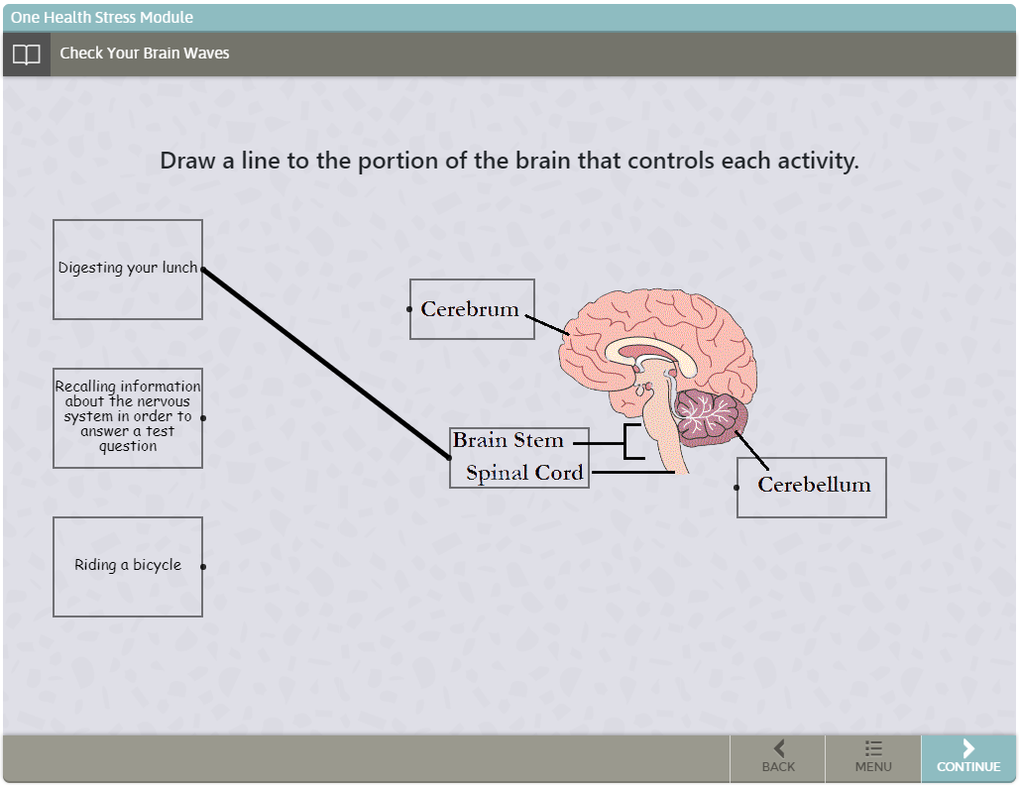
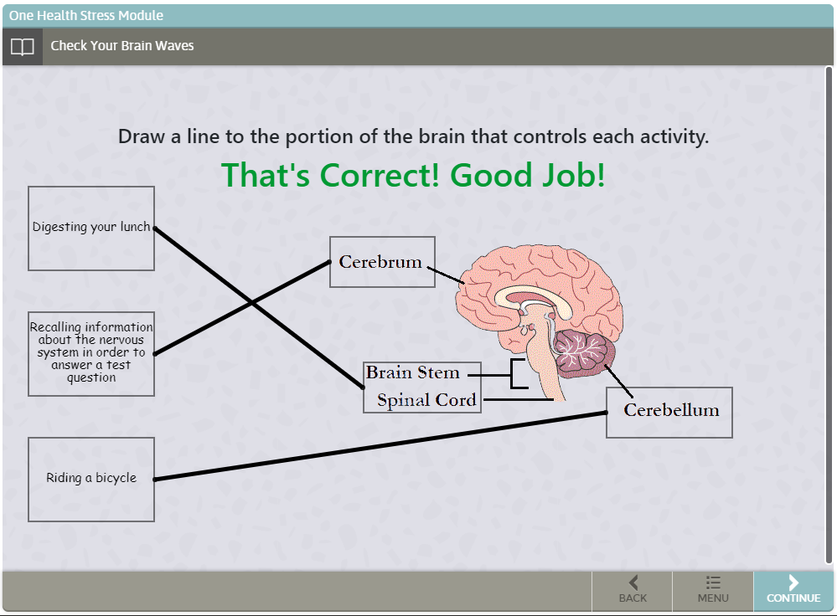
Animations in Stress Learning Content
Charles Rothrock, Shane Poldervaart , Siddharth Sundar, Kevin Tang, Yiqing Zhao, and Ben D’Antonio
Dept. of Computer Science and Engineering, Texas A&M University
Introduction
The Stepstone Environment
The TAMU PEER Program (Partnership for Environmental Education and Rural Health) strives to further K-12 STEM education in rural schools through online interactive courses
The Stress Module, part of their “One Health” curriculum, and its needed mini app animations for interactive student learning became the focus for our Software Engineering team.
StepStone is a web-based tool designed for educators without special technical or programming experience so they can create engaging, educational content
The path-building environment offers ways to make content paths, embed pictures, videos, questions and answers, etc., but does not provide support for more complex animations or games. Mini-apps, custom implementations of these animations, need to be manually embedded into the slides and cannot interact with any built in StepStone events and UI.
The development process for StepStone from your local machine to the production URL includes: creating a mini-app in local development, testing in the staging area which replicates the production environment (an FTP server and URL for viewing), production path configuration with Stepstone provided tools, and embedding the mini app in production.
Objectives
Make various Stress Module slides more interactive and engaging for students to enhance their learning experience
Complete a batch of animations, each corresponding to a slide and matching a description given by a Torri Whitaker, Content Specialist for the PEER Program
Enable each animation, or mini-app, to be browser compatible, mobile-friendly, heavily tested, and deployed to production in the StepStone environment
Allow mini-apps to be reusable for future slides and animations
Organization
Mini-app Design
The development process followed the Agile methodology with four iterations, each spanning a two-week period
The team consisted of Product Owner (Charles Rothrock), Scrum Master (Benjamin D’Antonio), and four other developers
On a weekly basis, the team had a standup meeting where developers discussed progress and setbacks
Each iteration, the team met with our customer to update and receive feedback on progress
We used Pivotal Tracker for use stories, Discord for constant communication, Zoom for team and customer meetings, and GitHub for version control
Tech Stack:
Each mini-app was built with HTML5, JavaScript, and CSS
For testing, we used the following npm modules:
Cucumber.js for the BDD framework
Selenium Webdriver for browser simulation (Firefox, Chrome, Edge, Internet Explorer, etc.)
Chai as an assertion library used during automation
For any given animation, following development procedures and pushing the mini-app to production would result in something similar to the example shown below
Difficulties
Drag And Connect Animation
Organizing user stories with underspecified customer requirements caused user stories to change frequently
The StepStone environment is sandboxed in an “iframe” element which caused various sizing and loading problems
The staging environment (FTP server and staging URL) was shared across multiple developers, so only one developer could test their app at a time
To deploy our mini apps, the StepStone developers had to manually embed them into the slides in production
User clicks and drags lines for correct matchings
Results
Future Steps
The team completed 6 out of 7 user stories: spike (slide 15), Hangman (slide 20), Drag and Connect (slide 12, 42), Drag and Drop (slide 24, 66), Word Selection (slide 33), and Ordering Images (slide 27).
These animations are currently in production in their respective slide numbers within the Stress Module.
All completed user stories are compatible with most browsers (Chrome, Edge, Firefox, Safari).
All completed user stories are touch screen compatible except for Drag and Drop (slide 24, 66).
Automated tests cases were written for all completed user stories to ensure future reusability and development.
The team spearheaded working with the Stepstone environment and documented in detail for future teams
Complete the User Story that was not finished (User Story 7, Weighted Scales)
These animations were made to be reusable by other StepStone modules with minimal changes to code and content
Every StepStone module has the potential to benefit from the use of these apps or the integration of new ones, and teams are already gradually implementing them for various modules
StepStone needs an automated process of placing the finished mini-apps in production by each individual developer to enable faster turn-around during iterations
Adding support for interaction between StepStone and the mini-apps to allow StepStone do declare dynamic content and allow the mini-app interactions to prevent progress through the module steps
Lessons Learned
Communication within the team as well as with the customer is vital throughout the project, as we were able to get clarification on user stories and keep everyone up-to-date on progress
Creating a development environment that simulates the production environment helps ensure deployments go as smoothly as possible and minimizes debugging in production.
The initial phases of organization, setup, and research can be the hardest part of the development process.
Animations should be tested constantly during development for sizing and compatibility on various platforms (Chrome, Firefox, Edge; mobile, desktop, iPads; Windows, MacOS; etc.)
Thoroughly documenting all work completed is essential for enabling future teams to create great animations

